Slide 1
What is DevOps?

Slide 2
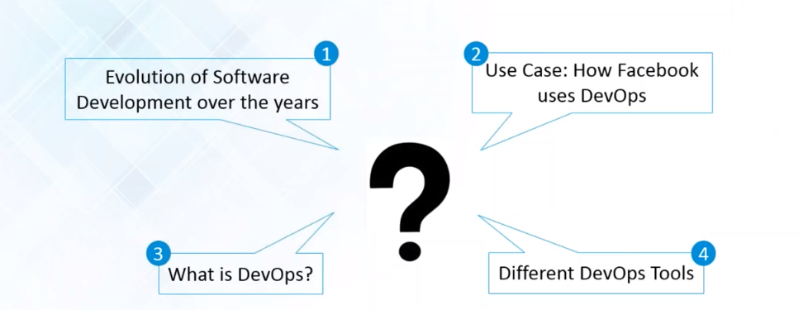
Let’s Understand !!

Slide 3
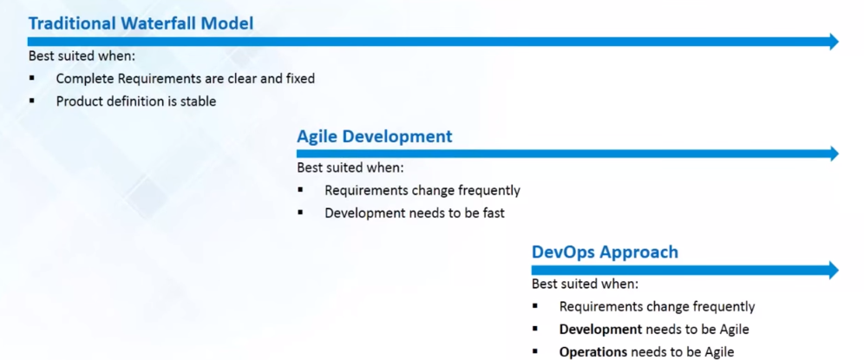
Approach – Software Development

Slide 4
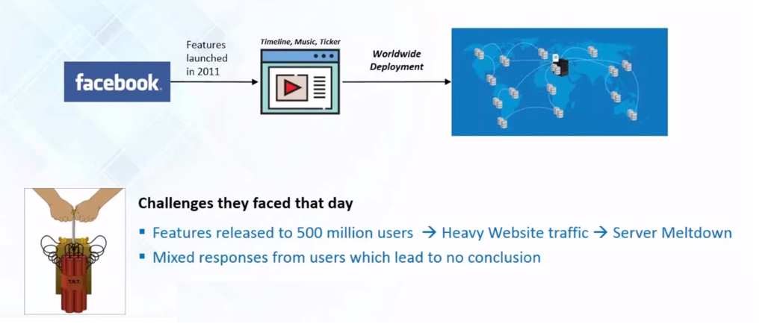
CASE study - FACEBOOK

Slide 5
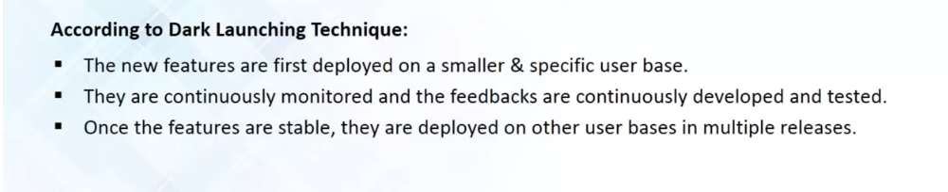
Dark launching ?

Slide 6
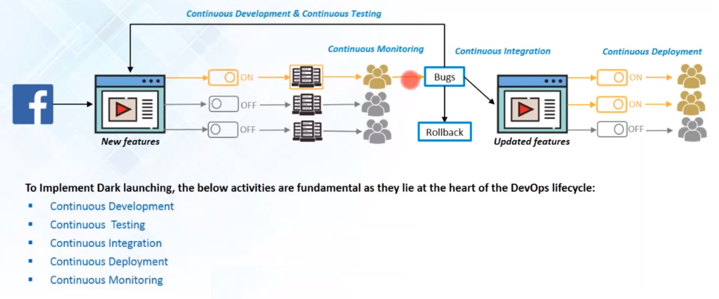
Dark launching technique

Slide 7
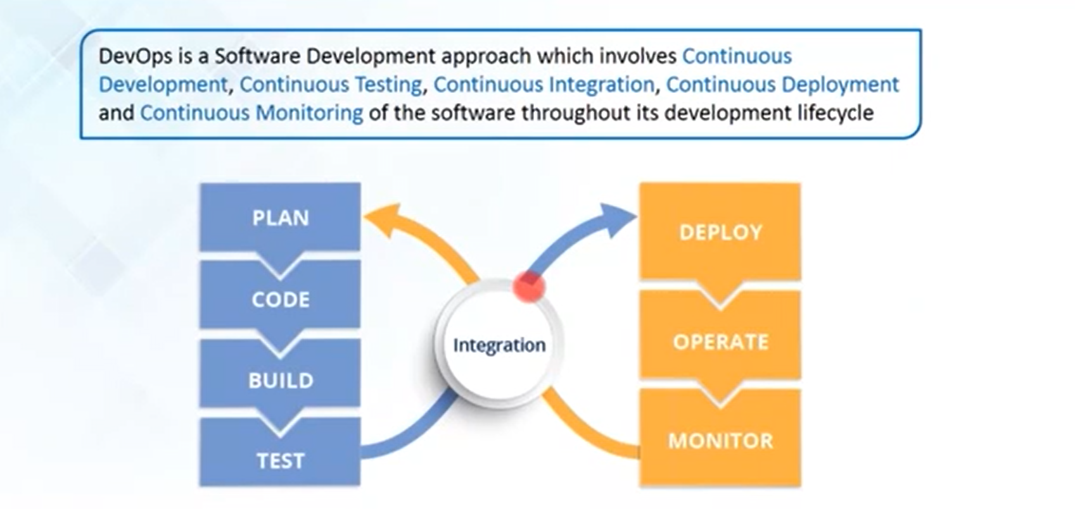
Devops?

Slide 8
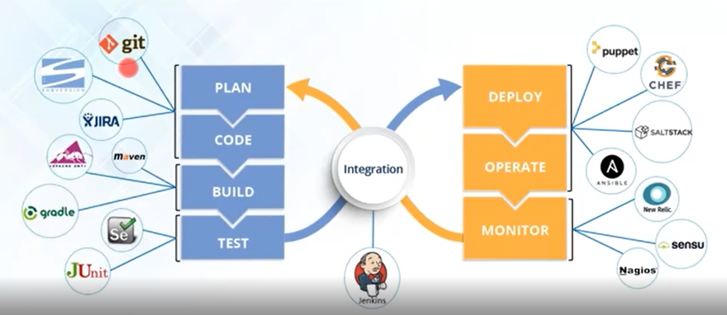
Devops tools?

Slide 9
!! THANK YOU !!

